Slide 1
moose for dcs world patrolling

Slide 2
ai_patrol_zone finite state machine
At the end of
each patrol route.
None
Start
Patrolling
Route
RTB
Returning
*
Detect
*
Detected
Status

Slide 3
a process that lets an ai patrol a patrol zone, while detecting targets.
Patrol an AI in a Patrol Zone,
while detecting targets,
which are reported.
3
AIRBASE 2
AIRBASE 1
PATROL ZONE
AIRBASE 4

Slide 4

the patrol process needs to be started.
Start the
AI_PATROL_ZONE
Processs
3
AIRBASE 2
Start
AIRBASE 1
PATROL ZONE
AIRBASE 4
AI

Slide 5
routes the AI to random points in the patrol zone.
The AI
is assigned a
random point in the
Patrol Zone
3
AIRBASE 2
AIRBASE 1
Route
PATROL ZONE
AIRBASE 4
AI

Slide 6
patrol a zone and don’t engage the enemy
Upon arrival, the
AI is assigned
another point in the
Patrol Zone
3
AIRBASE 2
AIRBASE 1
Route
AI
PATROL ZONE
AIRBASE 4

Slide 7
patrol a zone and don’t engage the enemy
The AI
is assigned a
random point in the
Patrol Zone
3
AIRBASE 2
Route
AI
AIRBASE 1
PATROL ZONE
AIRBASE 4

Slide 8
patrol a zone and don’t engage the enemy
3
AIRBASE 2
An enemy AI
is taking off…
AI
AIRBASE 1
PATROL ZONE
AIRBASE 4
AI

Slide 9
enemies are detected and reported through the Detected event.
The AI
is detecting the
approaching enemy.
3
AIRBASE 2
PATROL ZONE
The enemy AI
is approaching…
And is detected…
Tailor the Detected
event to identify
detected enemies.
Detect
AIRBASE 1
Detected
AI
AIRBASE 4
AI

Slide 10
the enemy is not engaged, merely a detection will happen.
The AI
is not reacting,
either tailor Detected event,
or use another AI_ class
to model defensive
or offensive behaviour.
3
AIRBASE 2
PATROL ZONE
!
AIRBASE 1
AI
AIRBASE 4
AI

Slide 11
patrol a zone and don’t engage the enemy.
When out of fuel,
the AI will fly
back home.
3
AIRBASE 2
AIRBASE 1
RTB
PATROL ZONE
AIRBASE 4
AI

Slide 12
moose for dcs world patrolling
PAT-001 – PATROLLING in ZONES

Slide 13
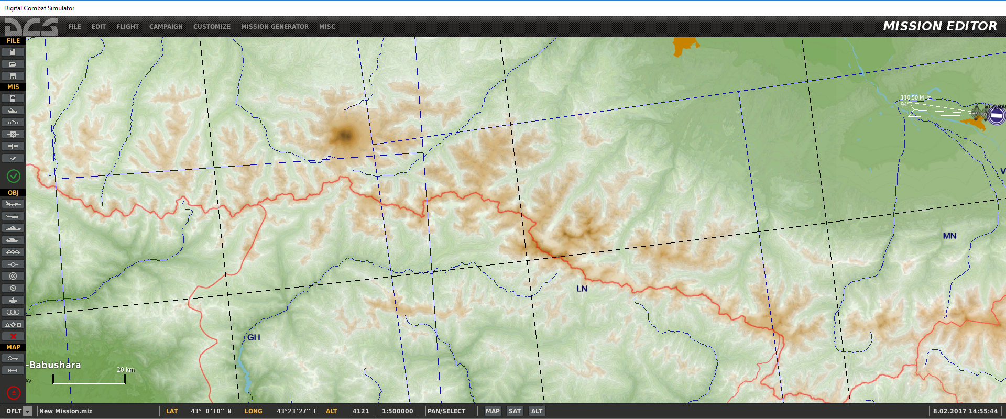
mountains
PATROL ZONE

